Slide 1
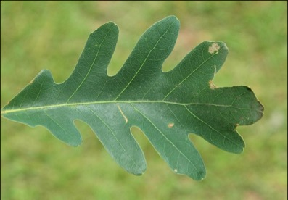
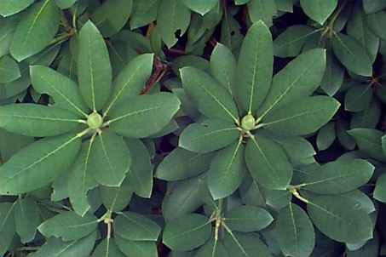
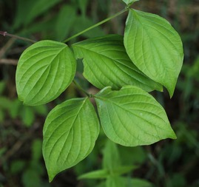
Tree Identification Primer
Wayne Daly & Cat Chamberlain

Slide 2
Outline
History of Botany
Incredible Tree Diversity
Intro to Taxonomy and Phylogeny
Key (pun intended!) Terms
Interactive Workstations (indoor or outdoor depending)
Notes:
Herbarium specimen – briefly discuss
Plant press
Hand lens
Field guide

Slide 3
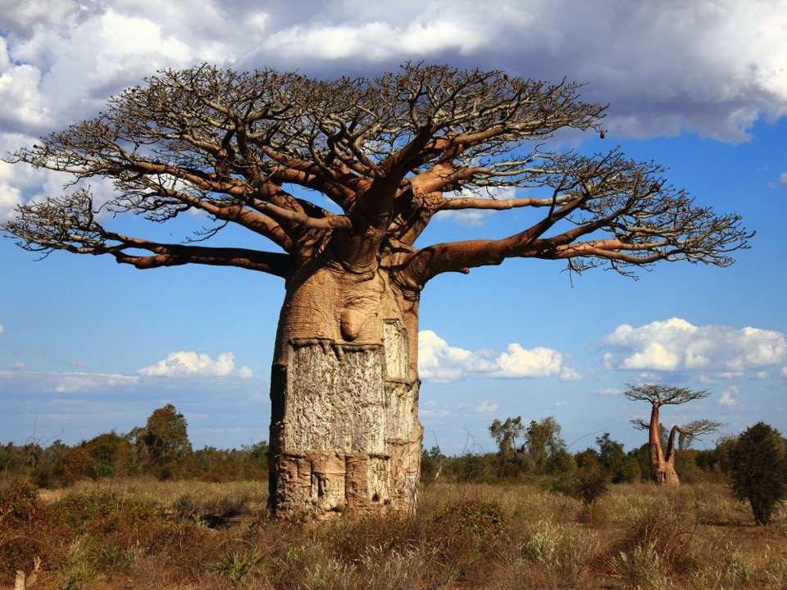
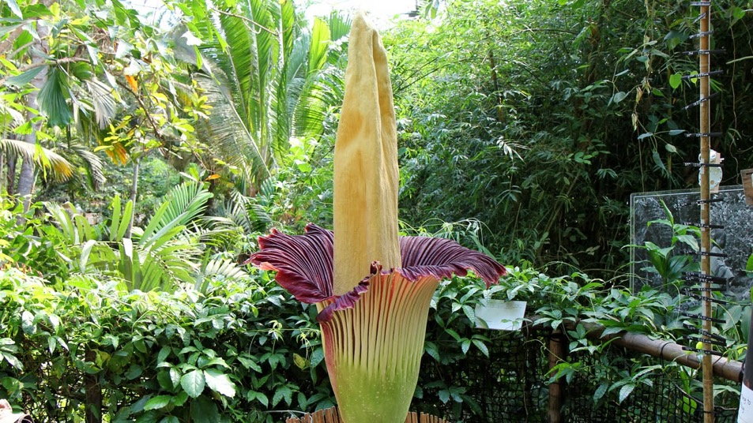
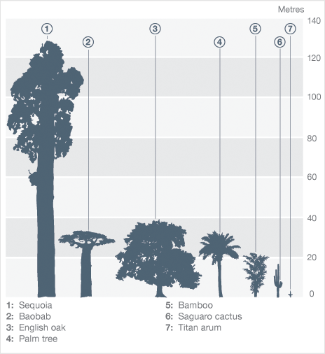
Incredible Plant Diversity!
Notes:
300000 species of plants, vast majority are seed plants
475M years old, first macroscopic 425MYA in Ireland
Baobabs: oldest known tree was 6,000 years old. Current is 1,700 years old
Can store 32,000 gallons of water in their trunks! In order to endure harsh droughts
6 African species and 1 Australian species – split was ~100 mya
I can’t find when they originated!!!! More than 100 mya though!
Ginkgo from 270 mya!!! WILD!
Titan arum is the largest unbranched inflorescence in the world (can reach over 10 ft tall!) – known for it’s corpse or carcass odor – pictures may be best! Usually only omits at night to attract beetle pollinators or flesh flies. The inflorescence is often ~100degF to attract these pollinators!!!
(Corypha umbraculifera or the talipot palm has the largest inflorescence in the world but it’s branched)

Slide 4
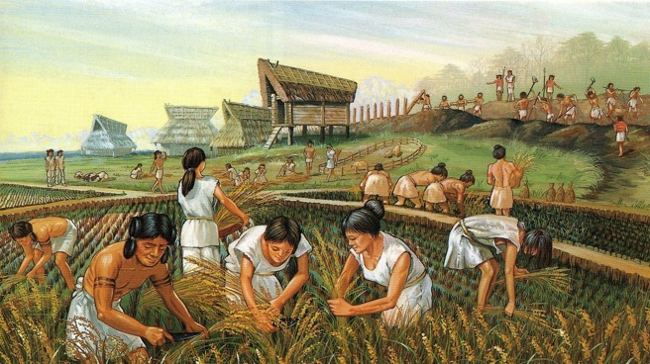
History of Botany
Paleolithic: hunters and gatherers; stone tools
Neolithic: ~12,000 years ago; Age of Agriculture
Notes:
Paleolithic 3 million years ago – 12000 years ago
Neolithic: beginning of domestication of plants, people start to understand how plants grow and develop and led to irrigation and eventually deforestation

Slide 5
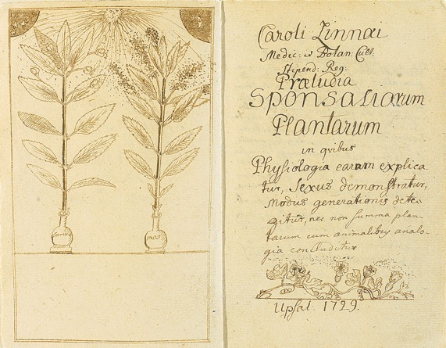
History of Botany: Enlightenment
Early depictions of leaf forms (1738)
Introduction of the Scientific Method
Society began using science and reason over politics and religion
Explorers were teams of Botanists and Zoologists
Age of Reason and Scientific Discovery
Pollination depicted by Carl Linnaeus (1729)
Notes:
17th century – scientific method
Carl Linnaeus’s first voyage was to Lapland at the age of 25 (1732) – pictured above after the journey wearing traditional dress of the Sami people

Slide 6
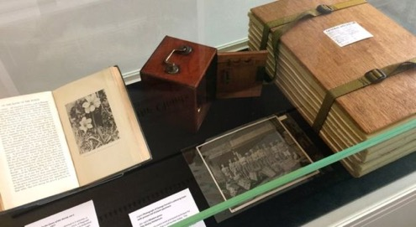
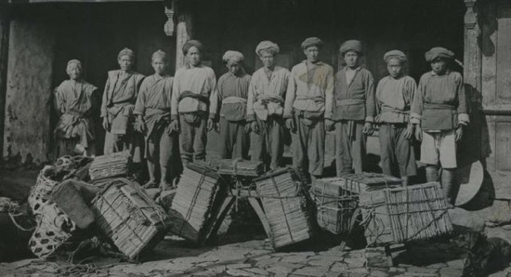
20th Century Botanists
Exploration to China began
Reginal Farrer (1880-1920)
George Forrest (1873-1932)
Notes:
Farrers took seeds from an expedition to China, loaded them in a shotgun and shot them across a rock cliff and gorge beside his family home, creating a beautiful rock garden full of rhododendrons and lilacs
Forrest collected over 31,000 specimens from China and discovered over 1,200 new plant species! Nearly died on numerous expeditions until dying of heart attack during an expedition to Tengyueh
Talk about a plant press here – how to preserve specimens to be used for a herbarium later
Herbarium: essentially a museum for plants
Back in the day, thought to be useful for understanding our flora but now we can use herbarium specimens to track climate change
some phenologists use specimens to see what plants flowered or leafed out, others use them for tracking types of herbivory and how the intensity of herbivory has changed over time. Also useful for assessing ranges of species, introduction of invasive species, and having a record of species that have gone extinct

Slide 7
First plant life on land was ~400 mya (million years ago)
Notes:
Carl Linnaeus is known as the ”father of modern taxonomy” – which is the classification of organisms. He is the creator of binomial nomenclature (e.g. Fagus grandifolia) and he wrote most of his work in Latin
And would sign his name Carolus Linnæus, adopting the binomial nomenclature method. His original name was Carl von Linnê
In those days, taxonomists used physical, morphological features to identify species and the classify them. Now, we integrate DNA barcoding and genetics, which has brought to light mistakes made in past trees
One example where genetics are essential around here is diciphering between the Red Oak (Quercus rubra) and the Black Oak (Quercus velutina)
We will focus on Dicots (or deciduous trees)
Point out conifers and cycads here to show how much older gymnosperms are than angiosperms and that there is separation on the tree which shows why they are so different looking

Slide 8

Evolutionarily Distinct: (kind of) New approach to conservation
$5
???
Notes:
EDGE: Evolutionarily Distinct and Globally Endangered
Handleys slender mouse opossum

Slide 9
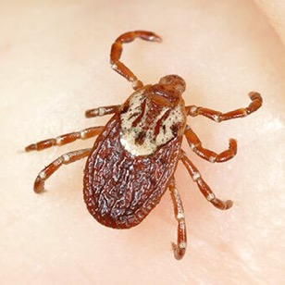
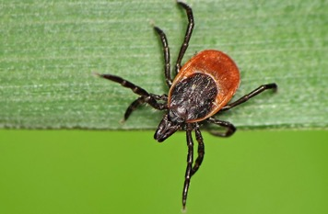
Why Identify?
Appreciate nature all the more
Safety!
Notes:
Poison Ivy! Talk about this here and make sure everyone feels comfortable with what it looks like.
And then use this opportunity to talk about the ticks this year. Stress the number and intensity of them and to make sure everyone checks themselves and their dogs after even walking through the arboretum.

Slide 10
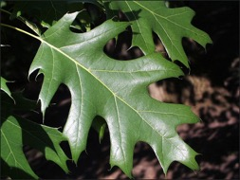
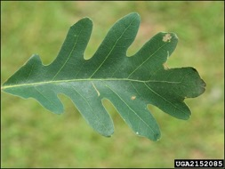
TAXONOMY:
Classification of organisms
PHYLOGENETIC (or evolutionary) TREE: branching diagram (or tree) showing evolutionary relationships among species
KINGDOM
PHYLUM
CLASS
ORDER
FAMILY
GENUS
SPECIES
Major similarities:
e.g. Fagaceae family – Fagus (Beech) and Quercus (Oak)
Even more similar!
Quercus rubra (Red) vs. Quercus alba (White)
Notes:
Beechs and Oaks often

Slide 11
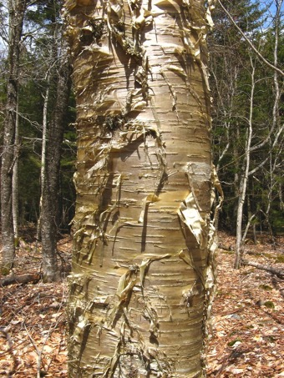
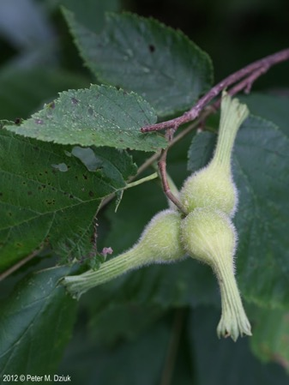
FIRST STEPS TO IDENTIFYING:
Have a Field Guide or some Dichotomous Key
Bring a Hand lens if you have one
Make a Plant Press if you’re interested. Or just use your field guide to press samples
Know what is important to look at!
Leaves
Buds
Flowers & Fruits
Bark
Use your nose! Try crushing leaves and see if they release an odor

Slide 12
What is a tree?
DEFINITON: a woody perennial plant, typically having a single stem or trunk growing to a considerable height and bearing lateral branches at some distance from the ground.
Monocot vs. Dicot:
Monocot – does not have secondary growth in the stem
Dicot – secondary growth, which form tree rings
Notes:
Palm tree is a monocot, so that is largely why the stem is essentially the same width from the base to the tip. Monocots and dicots have a lot more differences (from the development of the embryo to the types of flowers) but we will focus on the stem growth here

Slide 13
What is a tree?
“Sedges have edges, rushes are round, and grasses have knees that bend to the ground”
Notes:
A grass is also a monocot! All grasses are in the Poaceae family – point out the parallel leaf venation pattern

Slide 14
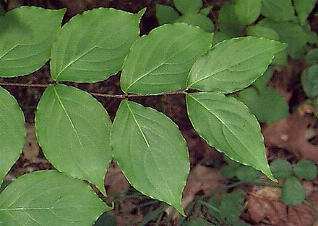
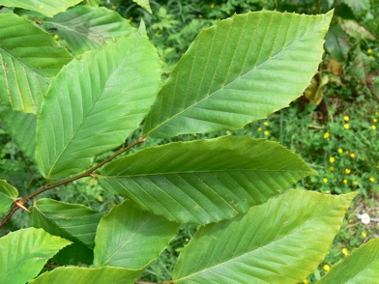
Dichotomous Key:
Opposite
Alternate
Notes:
Opposite Trees in New England: Maples, Ash, Dogwood, Honeysuckle/Viburnum, and Horse Chestnut
MADhorsehoney

Slide 15
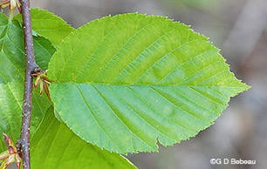
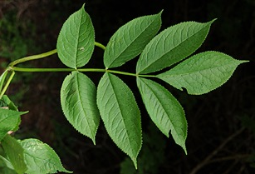
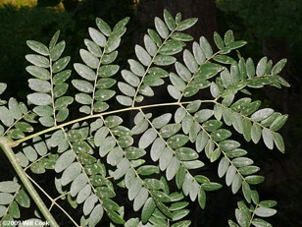
Dichotomous Key:
SIMPLE
COMPOUND
TWICE COMPOUND
Notes:
Opposite Trees in New England: Maples, Ash, Dogwood, Honeysuckle/Viburnum, and Horse Chestnut

Slide 16
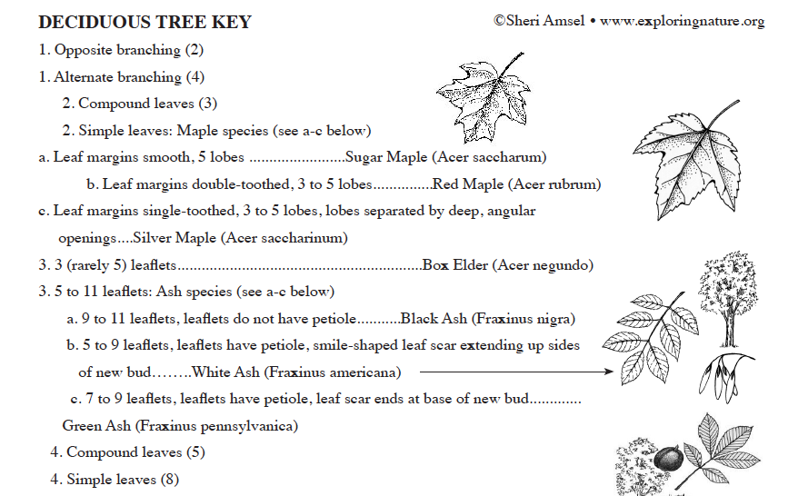
Dichotomous Key:
Notes:
Help run through what a key looks like and how to use before splitting off into groups

Slide 17
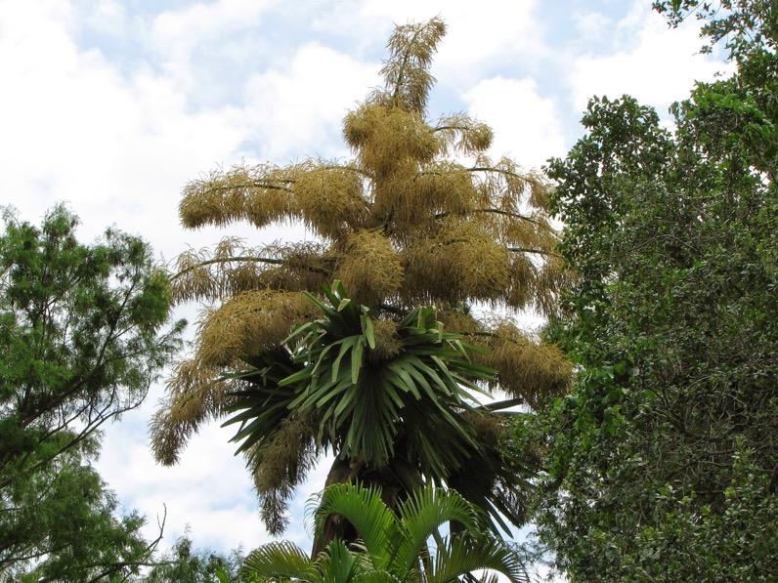
Questions before practicing your new skill?
Notes:
(Corypha umbraculifera or the talipot palm has the largest inflorescence in the world but it’s branched)

Slide 18
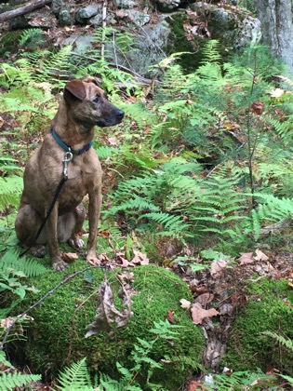
THANK YOU!
Please email me or Wayne with any questions, concerns, or suggestions!
Cat: cchamberlain@g.harvard.edu
Wayne: waynelmdaly@hotmail.com

